Slide 1
10X Genomics John Garbe Informatics Lead, UMGC

Slide 3
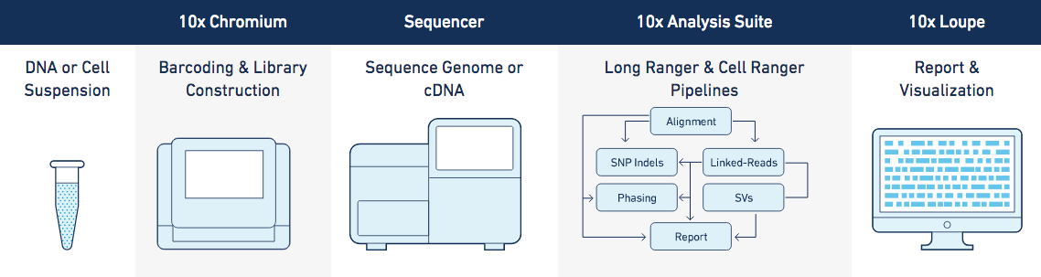
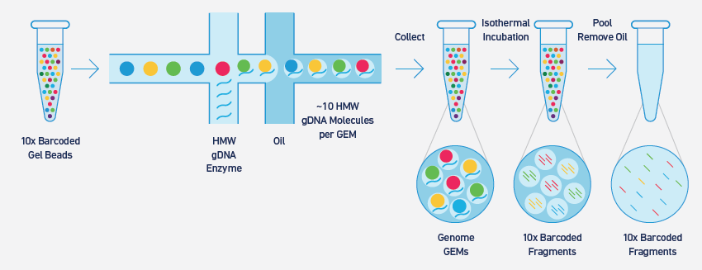

Slide 4
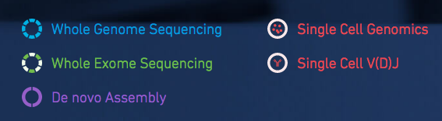
Applications
Notes:
V(D)J for T-cell analysis

Slide 5
Whole genome/exome sequencing
Calling and phasing of SNPs, indels, and structural variants
Sequencing depth
Genome: 40X
Exome: 60-80X
Optimized for human genome
Diploid genome required
Longranger software

Slide 6
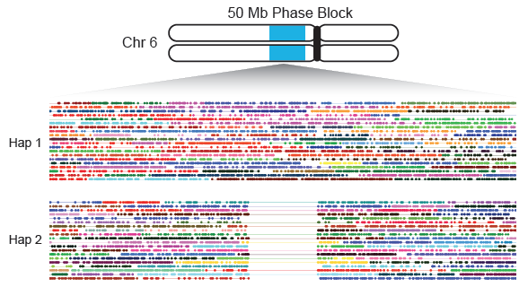
Whole genome/exome sequencing

Slide 7
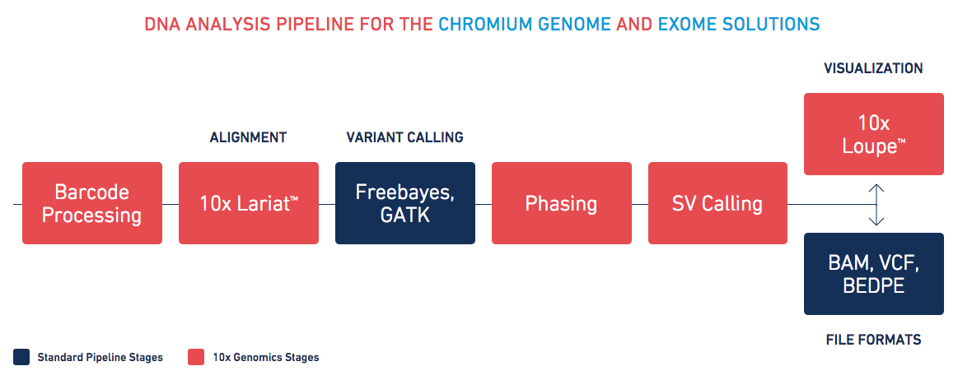
Whole genome/exome sequencing

Slide 8
Loupe example

Slide 9
De novo assembly
Diploid assembly
Designed for human genomes
Non-human assembly is experimental, not supported
Mammalian genomes: likely to work well
Non-germline human (cancer): unlikely to work well
High repeat content: may not work well (long run times)
Non-diploid genomes: unlikely to work well
Small genomes (100Mb+): may work, repetitive dna problematic
Large genomes (3.2Gb+): risky (8GB maximum)
100kb dna length
38x-56x sequence coverage
Supernova assembler
16+ cores
384GB ram
2TB disk space
3-15 days
ARCS: third-party hybrid assembler

Slide 10
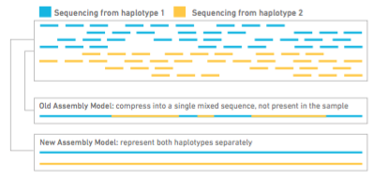
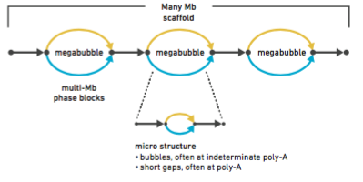
De novo assembly

Slide 11
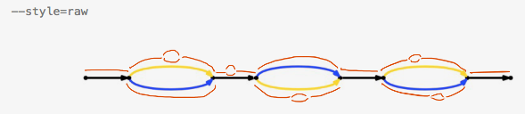
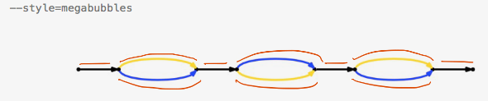
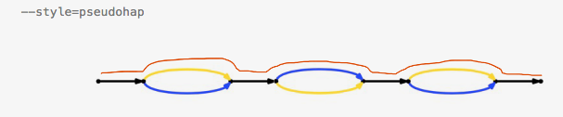
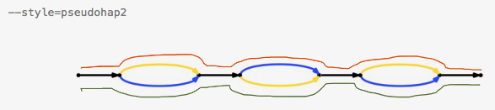
De novo assembly
Notes:
Raw: every edge in the assembly reported as a fasta record
Remaining: flatten bubbles (select branch with highest coverage), merge gaps, drop reverse complement edges

Slide 12
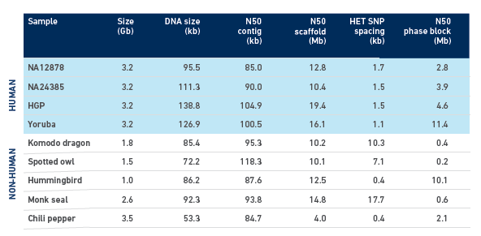
De novo assembly

Slide 13
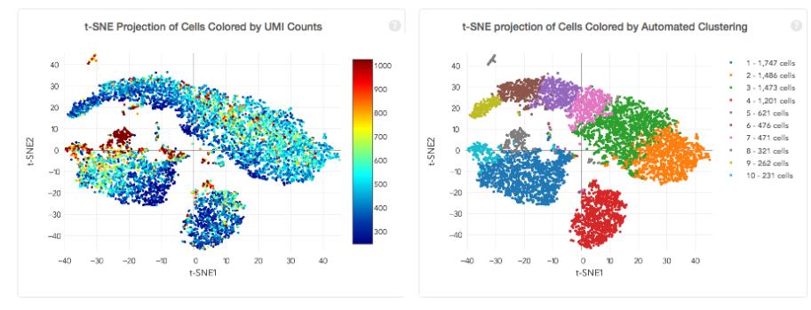
Single Cell
Single Cell Genomics
3’ expression measurement
Profile 500 – 10,000 cells
Cellranger analysis, Loupe Cell Browser
Cellranger example

